Slide 1

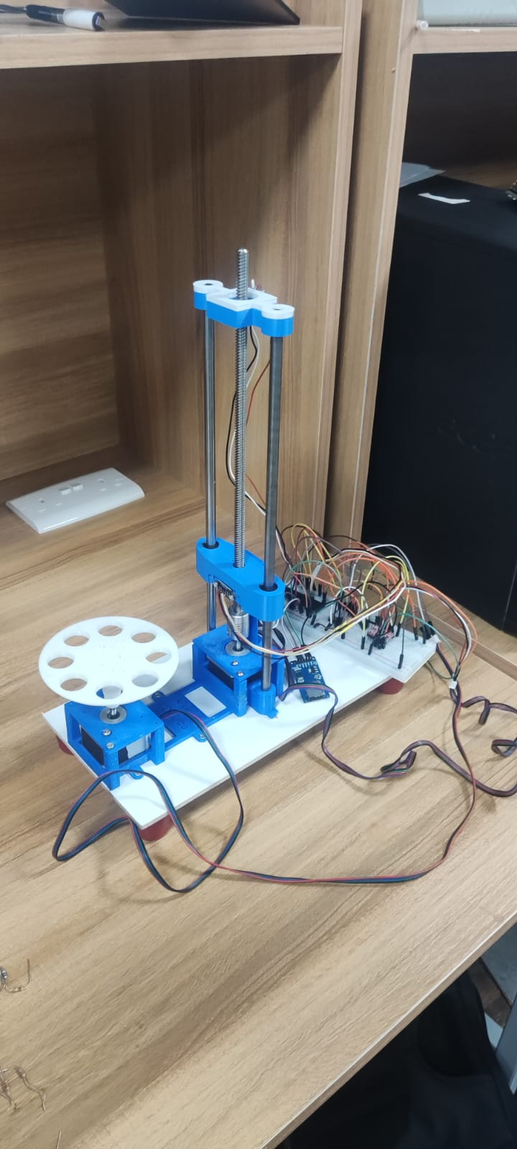
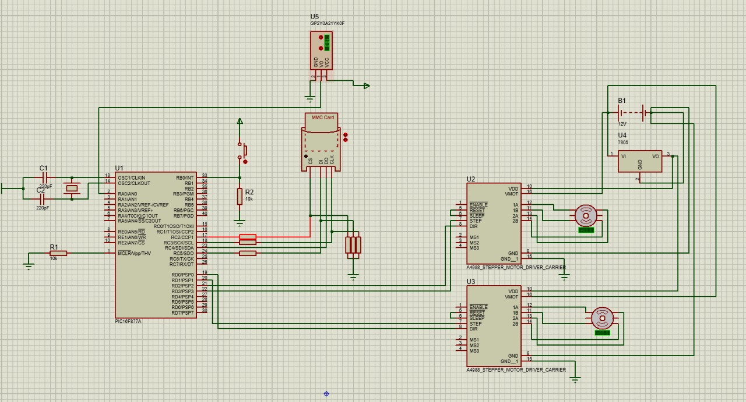
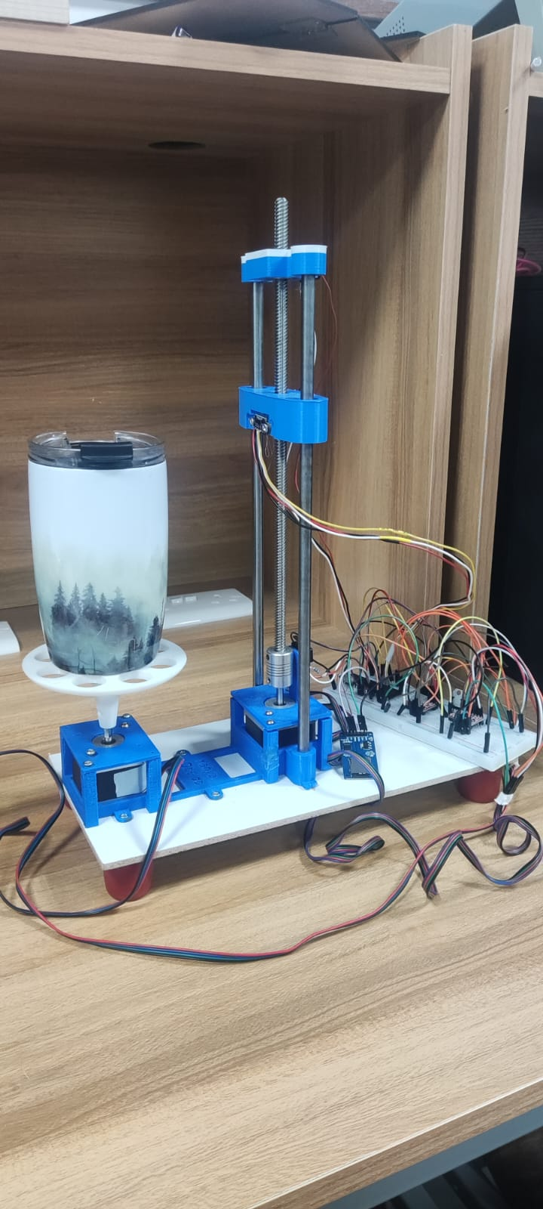
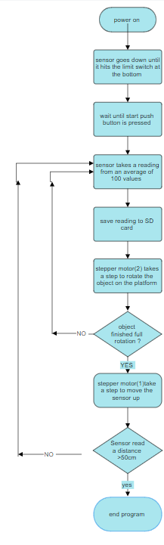
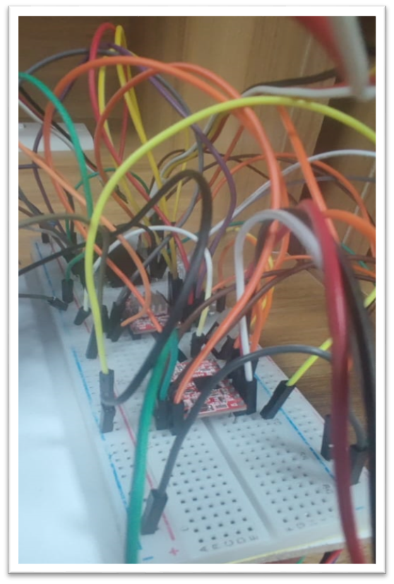
3D scanner
A. Al-Momani , F. Hussein and M. SAIDI
Supervisor: Dr. Belal Sababha.
Embedded Systems Final Design Project, Fall 2023
King Abdullah II School of Engineering
Princess Sumaya University for Technology
Introduction
We will create a 3D scanner, which is allows the sensor to move vertically, capturing detailed readings of an object placed on a rotating platform.
In our project the machine should begin with the sensor descending to the base of the lead screw, halted by a limit switch. It then takes a reading of the object before the platform makes a minute rotation. This process repeats until a full rotation is completed, providing a comprehensive scan of the object’s surface at that particular height
In addition to a voltage regulator, a micro-SD reader for data storage, and two A4988 stepper motor drivers for exact motor control, the project will make use of a PIC microcontroller for code design.
This 3D scanner is a useful tool for many purposes, from quality control to product development, as it promises to provide high-resolution 3D scans in a small, affordable package.
Results
We finally have a device that gives us a 3D file in stl format that saved on the SD card
Design
Figure 3: 3D SCANNER
Figure 1:3D scanner (schematic)
Figure 4: Scanning process for an object
Figure 5: The circuit
Figure 2: 3D Scanner (flow chart).
Conclusion
Designing a 3d scanner was a real challenge since it needs a great understanding of the embedded systems science and it also needs patience because you will face lots of trial and error, but in conclusion we are really confident in our project because we think it meets the highest design requirements and good functionality

